Slide 1
Toil & Automation

Slide 2
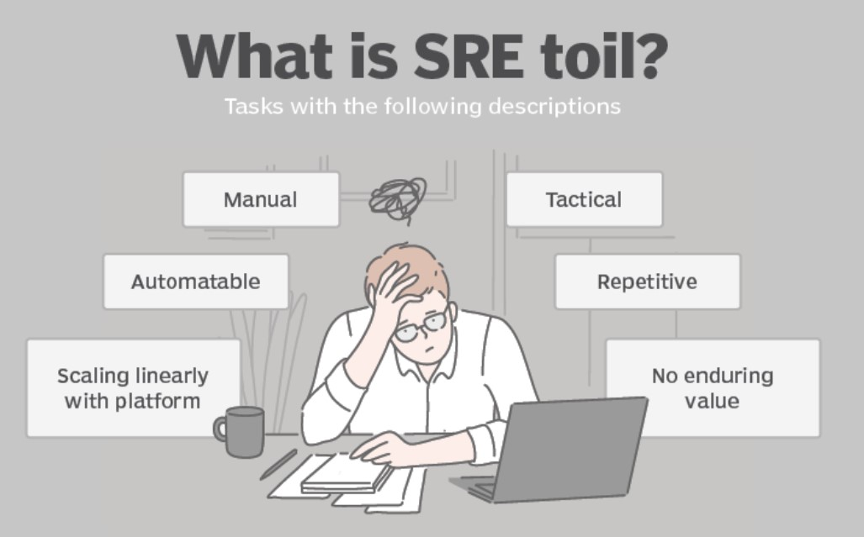

Slide 3
Characteristics of Toil:
Repetitive: Tasks are done over and over, often without significant variation.
Manual: Involves human intervention rather than automation.
Non-Strategic: Does not lead to long-term improvements.
Tied to Operations: Often linked to system upkeep, troubleshooting, or handling incidents.
Proportional to Scale: As systems grow, toil tends to grow linearly, increasing operational burdens.

Slide 4
Examples of Toil:
Manually restarting servers or services.
Routine system checks (e.g., CPU usage, memory checks).
Running the same queries or commands repeatedly to address issues.
Managing deployments manually without a pipeline.
Responding to frequent and predictable alerts.
Handling quota requests
Applying database schema changes
Reviewing non-critical monitoring alerts
Copying and pasting commands from a playbook

Slide 5
Toil consequences
For the individual, high-levels of toil lead to:
Discontent and a lack of feeling of accomplishment
Burnout
More errors, leading to time-consuming rework to fix
No time to learn new skills
Career stagnation (hurt by a lack of opportunity to deliver value-adding projects)
For the organization, high-levels of toil lead to:
Constant shortages of team capacity
Excessive operational support costs
Inability to make progress on strategic initiatives (the “everybody is busy, but nothing is getting done” syndrome)
Inability to retain top talent (and acquire top talent once word gets out about how the organization functions)

Slide 6
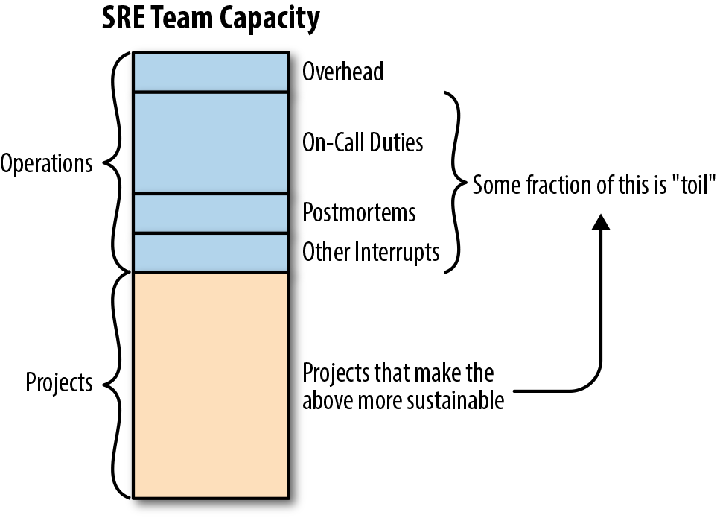
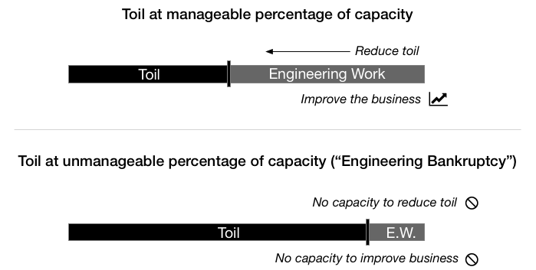

Slide 7
How to reduce toil
There are many ways SRE minimizes the costs of toil. The following six techniques will help your IT organization improve SRE management.
Standardize
A lack of standardization leads to a more complex IT platform, which then increases toil. Minimize the number of IT platforms in place — for example, through different types of Unix, different versions of Windows Server and multiple separate hardware suppliers. Also, interrogate function repetition. Multiple applications that carry out the same functions — for example, using overlapping customer relationship management and sales force automation applications — increases the complexity, and therefore toil, of the environment. Standardization makes it easier to manage the platform as other steps are taken.
Reuse
Many toil tasks are repetitive. Therefore, once a fix is found for a task, engineers should apply it repeatedly to the same task, even on a different part of the platform. A library of callable scripts will help reduce toil. Increasingly, many tools used in SRE come with preexisting libraries that cover the most common areas.
Monitor
Triage, also called firefighting, is the worst thing that can happen to an IT platform. A problem that affects users harms the business and creates a negative perception from the business to IT while encouraging responders to cut corners. Operations teams must institute a solid procedure for monitoring the entire IT platform — a system that can identify possible problems before they become issues and which can then initiate events to fix the problem.
Automate
Humans are, unfortunately, often the root of problems in the IT environment. Unchecked changes can domino into catastrophic issues across the platform. Therefore, look to systems that check any change before implementation, automate that change and roll back if any problems are identified post-deployment.
Improve
Poor code leads to more problems, which means more toil. Use an integrated DevOps approach with solid testing to improve initial code quality, with automated feedback loops between operations and development to raise any identified issues, along with indications of priority for fixing.
Embrace new technologies
But not too fast — and don’t assume they will remedy all problems. Machine learning, deep learning and AI will increasingly improve SRE capabilities but are still at an early stage of maturation in the market. However, waiting until they are 100% proven will cost your organization in toil levels. Introduce such technologies in small, defined areas and judge their effectiveness. Organizations can then begin to roll them out across the total platform as faith in their capabilities grows.

